Slide 1
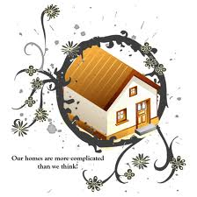
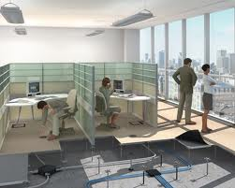
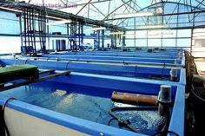
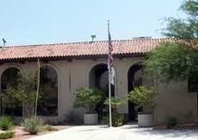
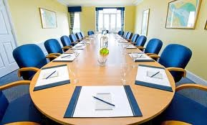
Minimal Metadata for the Built Environment: A MIxS extension
(MIxS-BE)
Lynn Schriml (University of Maryland) and Elizabeth Glass (Argonne)
Notes:
How do people describe indoor information ?
A lot of unknowns.
Initial metadata: sample name + sacks of data … the microbes in this room
How often are the filters changed, the type of lighting, what are you sitting on.
How many people are in the room

Slide 2
http://mobedac.org/
MoBEDAC:
Identified the need for built environment-related metadata fields
Established a working group: to coordinate with GSC MIxS working group

Slide 3
MoBeDAC
Jason Stajich
University of California Riverside
Folker Meyer,
University of Chicago
Rob Knight
University of Colorado Boulder
Mitch Sogin
Marine Biological Laboratory
BE minimal metadata working group Argonne: Elizabeth Glass, Folker Meyer, Andreas Wilke, Katya Dribinsky
Colorado: Rob Knight, Doug Wendel, Robert Van Pelt, Gail Lesley Ackermann
microBEnet: Hal Levin UC Davis: Jonathan Eisen
UMD-SOM,IGS: Lynn Schriml
MBL: Mitch Sogin, Anna Shipunova, Sue Huse
Sloan: Paula Olsiewski

Slide 4
Why Indoor ?
Microbial Composition and Diversity
Understanding relationship between Indoor Microbes and Human Health
Evaluating and comparing Built Environment microbial sequences
Why Expand the MIxS standard ?
The Built environment is a complex community
Standard terminologies must be applied to each sequenced genome in order to carry out comparative analysis.
Notes:
So few indoor studies
These studies are indicating a vast abundance and diversity in the indoor environment

Slide 5
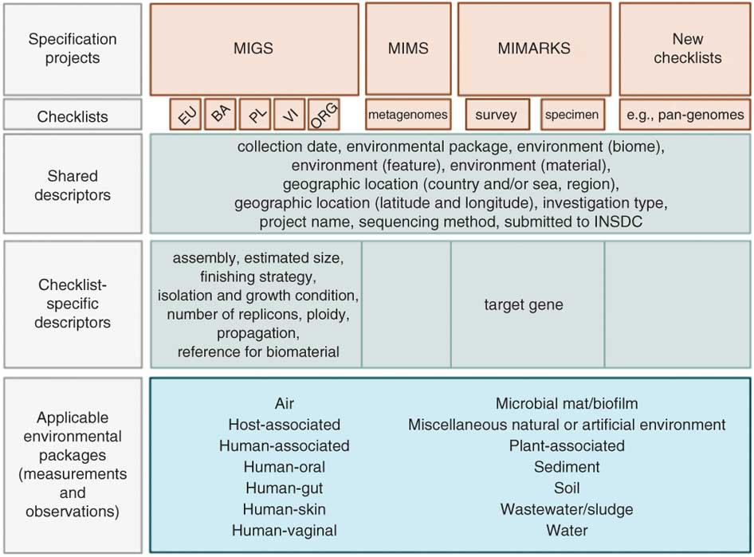
Notes:
Folker Meyer

Slide 6
Building a minimal metadata description of the built environment
Current Steps:
-- identify reported metadata from literature, SRA
-- solicit Sloan BE community input (Jessica Green, Lew Harriman, Jordan Peccia)
-- formulate initial Built Environment package
-- present initial metadata terms, definitions at GSC meeting
-- coordinate with MIxS working group
-- finalize BE env package
-- procure approve from GSC MIxS group leader : Pelin Yilmez
Next Steps:
-- distribute to BE community: microbe.net
-- incorporate BE package into MIxS packages
-- utilize BE package to annotate MoBeDAC datasets
BE Core
environmental package-air
BE- building properties
BE - sample properties
Notes:
Several steps, working with the community, determining data types to collect. Working with GSC to build the minimal standard

Slide 7
BE Core
package item | definition | requirement | value syntax | occurrance
surface material | surface materials at the point of sampling | E | [concrete|wood|stone|tile|plastic|glass|vinyl|metal|carpet|stainless steel|paint|cinder blocks|hay bales|stucco|adobe] | 1
surface-air contaminant | contaminant identified on surface | E | [dust|organic matter|particulate matter|volatile organic compounds|biological contaminants|radon|nutrients|biocides] | M
relative air humidity | partial vapor and air pressure, density of the vapor and air, or by the actual mass of the vapor and air. | M | {float} {unit} [%] | 1
absolute air humidity | actual mass of water vapor - mh20 - present in the air water vapor mixture. | M | {float} {unit} [kg|lb] | 1
surface humidity | surfaces: water activity as a function of air and material moisture | E | {float} {unit} [%] | 1
air temperature | temperature of the air at the time of sampling | M | {float} {unit} [deg C] | 1
surface temperature | temperature of the surface at the time of sampling | E | {float} {unit} [deg C] | 1
surface moisture pH | pH measurement of surface | E | {integer [0-14]} | 1
building occupancy type | The primary function for which a building or discrete part of a building is intended to be used | M | [office|market|restaurant|residence|school|residential|commercial|low rise|high rise|wood framed|office|health care|school|airport|sports complex] | M
surface moisture | water held on a surface | E |  | 1
dew point | the temperature to which a given parcel of humid air must be cooled, at constant barometric pressure, for water vapor to condense into water. | X | {float} {unit} [deg C] | 1
mandatory (M), optional (X), environment-dependent (E) or not applicable (-), NA : not applicable

Slide 8
environmental package -air
package item | definition | requirement | value syntax | Occurrence
carbon dioxide | carbon dioxide (gas) amount or concentration at the time of sampling | M | {float} {unit} | 1
ventilation type | the intentional movement of air from outside a building to the inside through forced or natural movement of air. | M | [mechanical ventilation|forced ventilation|natural ventilation] | M
organism count | total count of any organism per gram or volume of sample,should include name of organism followed by count; can include multiple organism counts | M | {text};{float} {unit} | M
item can be used only once (1), multiple times (M), or none (0)

Slide 9
BE- building properties
package item | definition | requirement | value syntax | occurrence
indoor space | A distinguishable space within a structure, The purpose for which discrete areas of a building is used | M | bedroom, office, bathroom, foyer, kitchen, locker room, hallway, elevator | 1
indoor surface | Type of indoor surface | E | counter top, window, wall, cabinet, ceiling, door, shelving, vent cover | 1
filter type | A device which removes solid particulates or airborne molecular contaminants, | M | particulate air filter, chemical air filter, low-MERV pleated media, HEPA, electrostatic, gas-phase or ultraviolet air treatments. | M
heating and cooling system type | methods of conditioning or heating a room or building | M | radiant system, heat pump, forced air system, steam forced heat, wood stove | M
substructure type | The substructure or under building is that largely hidden section of the building which is built off the foundations to the ground floor level | X | crawlspace, slab on grade, basement | M
building setting | A location (geography) where a building is set | M | urban, suburban, exurban, or rural | 1
light type | Application of light to achieve some practical or aesthetic effect. Lighting includes the use of both artificial light sources such as lamps and light fixtures, as well as natural illumination by capturing daylight. Can also include absence of light. | M | natural light, electric light, or none | M

Slide 10
BE - sample properties
package item | definition | requirement | value syntax | occurrance
sample size sorting method | method by which samples are sorted | X | open face filter collecting total suspended particles, "prefilter to remove particles larger than X micrometers in diameter, where common values of X would be 10 and 2.5 full size sorting in a cascade impactor" | M
space typical state | customary or normal state of the space | M | [typical occupied|typically unoccupied] | 1
typical occupant density | customary or normal density of occupants | M | {float} | 1
occupancy at sampling | number of occupants present at time of sample within the given space | M | {integer} | 1
occupant density at sampling | average number of occupants at time of sampling per square footage | M | {float} | 1
Notes:
Compliance: is a reality… simple set of terms to add
This metadata will record where a sample is collected.
Provides a place to collect the data

Slide 11
DATA
MoBeDAC data from SRA
18 Projects
2 air (Singapore, indoor shopping center)
16 waste water (2007, Jones Island, WI, sewage influent)

Slide 12
Sloan Built Environment projects … in the MoBEDAC pipeline
Expanding the scope of BE data
retail store microbial community
neonatal intensive care unit air, water, and surface microbial profiles
microbiome associated with surfaces in the home
built environment of drinking water
viral metagenomic analysis of workplace environments
indoor microbial communities and indoor air quality
diversity and structure of bacterial communities in kitchens
microbes in occupied and unoccupied school rooms
fungal barcodes and use them to explore the indoor environment
natural vs. mechanical ventilation on indoor air microbial diversity and abundance of a health care facility
Notes:
Current project metadata representation – improve, new project will apply standard to. built environment of drinking water

